Slide 1
Development of IoT based Smart security and Monitoring System for Agricultural Farm

Slide 2
Members:
Md. Samiul Islam- 011 171 160
Moinul Hossain Miraj- 011 171 152
Ayesha Sultana Orna- 011 171 163
Sadia Sarwar Tushi- 011 171 162
Nusrat Jahan- 011 171 133
Sajib Kumar Saha- 011 171 167

Slide 3
Supervised By:
Course Teacher:
Suman Ahmmed
Asst. Professor, CSE | Director,
Centre for Development of IT Professionals (CDIP)
Hasan Sarwar
Professor, CSE

Slide 4
Outline
Complex Engineering Problem
Business Value
Literature Review
Big Picture
Objective
Methodology
Design Thinking
Results
Standards
Constraints
Major Challenges
Complete Work Schedule
Future Work
Conclusion

Slide 5
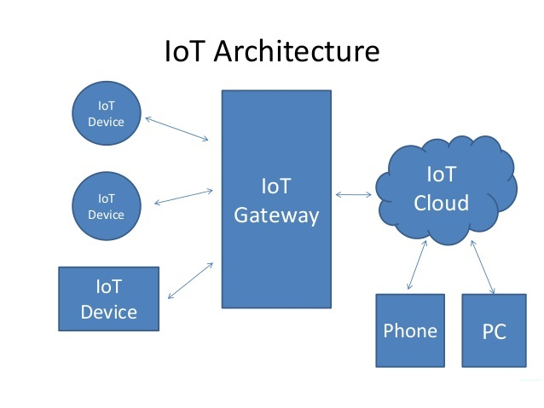
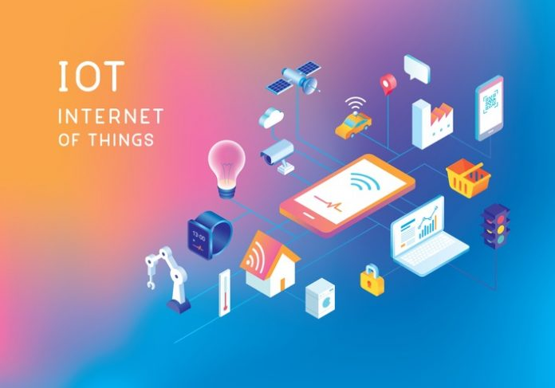
About Internet Of Things
As we know IOT is a system embedded with sensors, software, and other technologies for the purpose of connecting and exchanging data with other devices and systems over the Internet.

Slide 6
Why is ours a complex engineering problem?
Requires in-depth knowledge about the environment and certain types of modules.(WP1, EA1)
Creating connection between software and hardware.(WP2, EA2)
Creating a smart Agro Farm requiring abstract thinking.(WP3)
Real-world agricultural problem.(WP4 & EA3)
In-depth knowledge about different programming languages.(WP5, WK6 & EA5)
Has managers and different customers with requirements as stakeholders.(WP6)

Slide 7
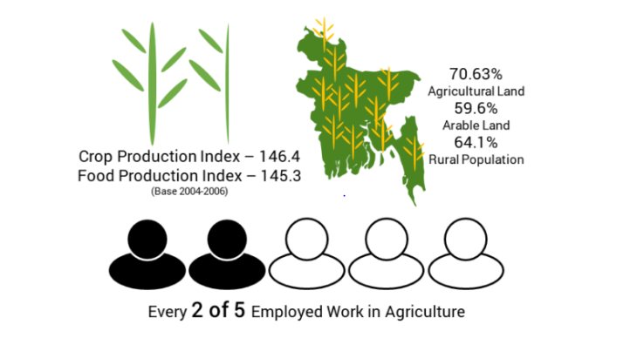
Business Value
Why will Government take initiatives for the development of agriculture?
And also Bangladeshi government and the World Bank launched ”Climate Smart Agriculture Investment Plan (CSAIP)” on 2019. So it is given high priority it is safe to say the value of our proposal will be given importance in terms of making Agro Farm smarter.

Slide 8
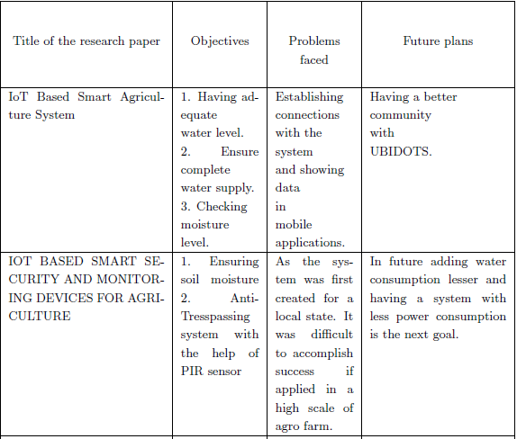
Literature review

Slide 9
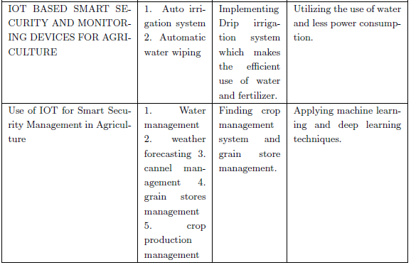
Literature review

Slide 10
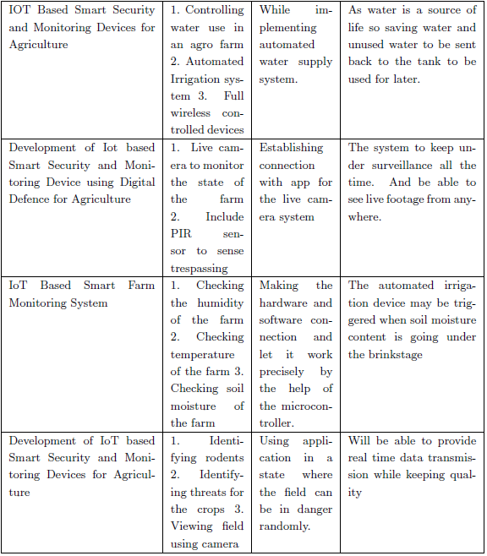
Literature review

Slide 11
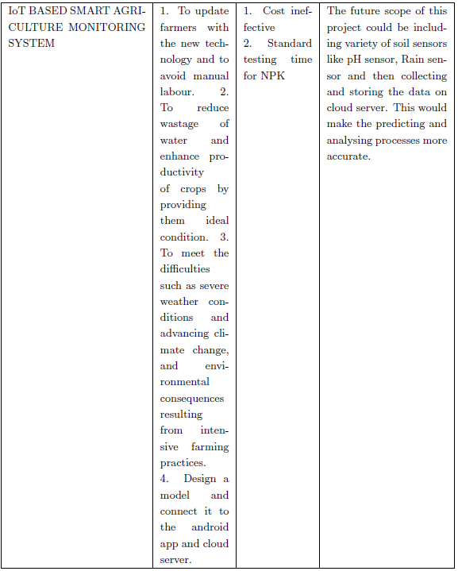
Literature review

Slide 12
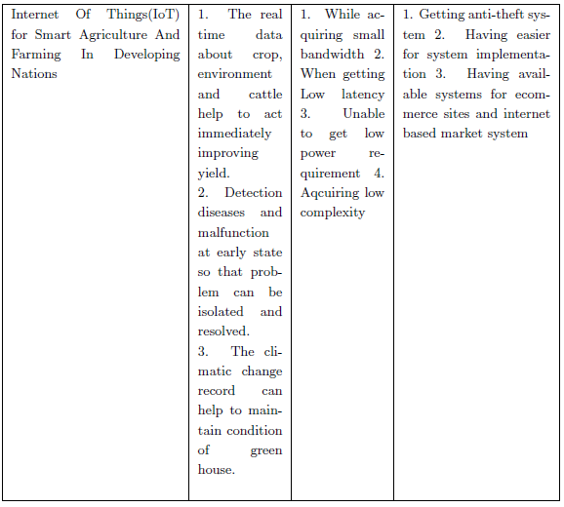
Literature review

Slide 13
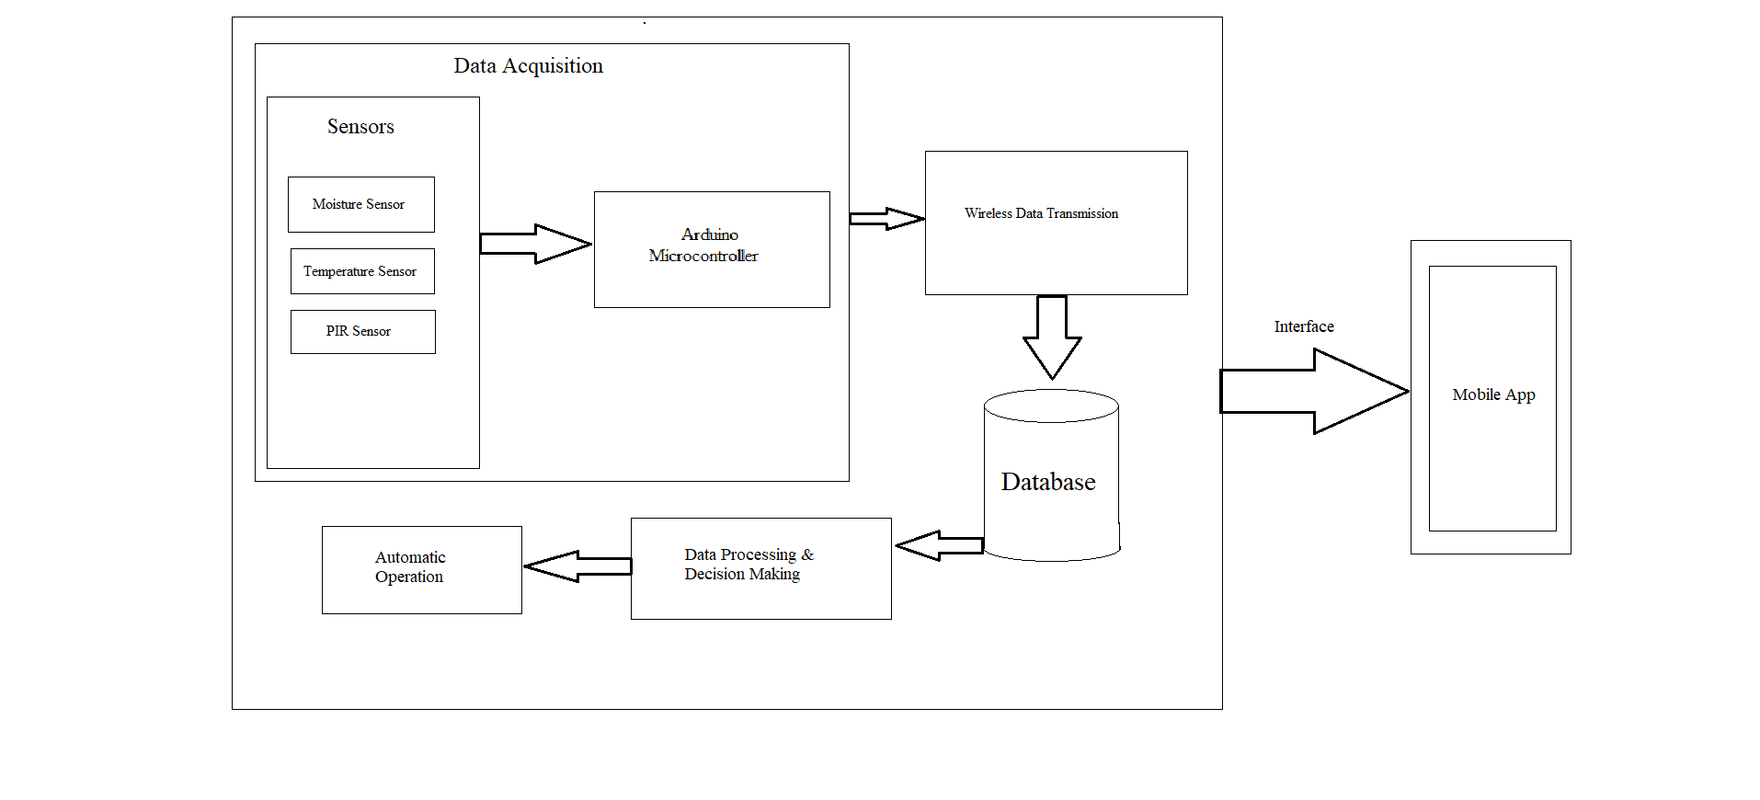
Big Picture(Design Functionalities)

Slide 14
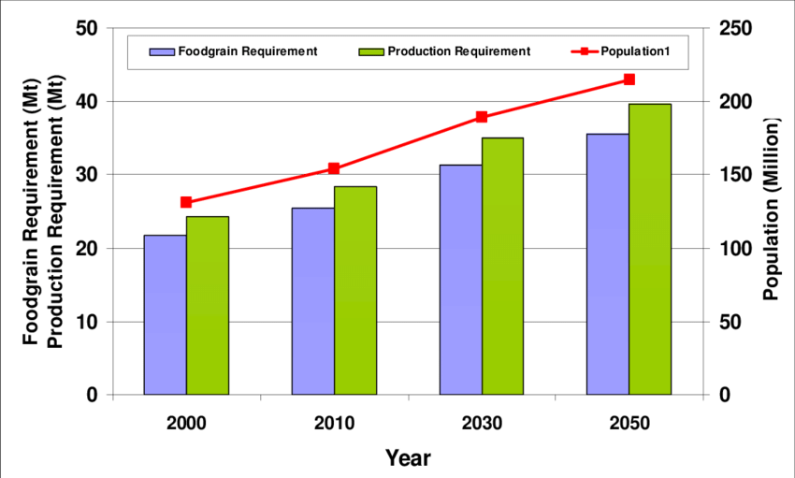
What problems we are facing in agriculture?
Rapid shrinkage of agricultural land
Population growth
Inadequate supply of agricultural inputs like fertilizers and seeds
Climate change
Lagging technology

Slide 15
Occupational Pattern:

Slide 16
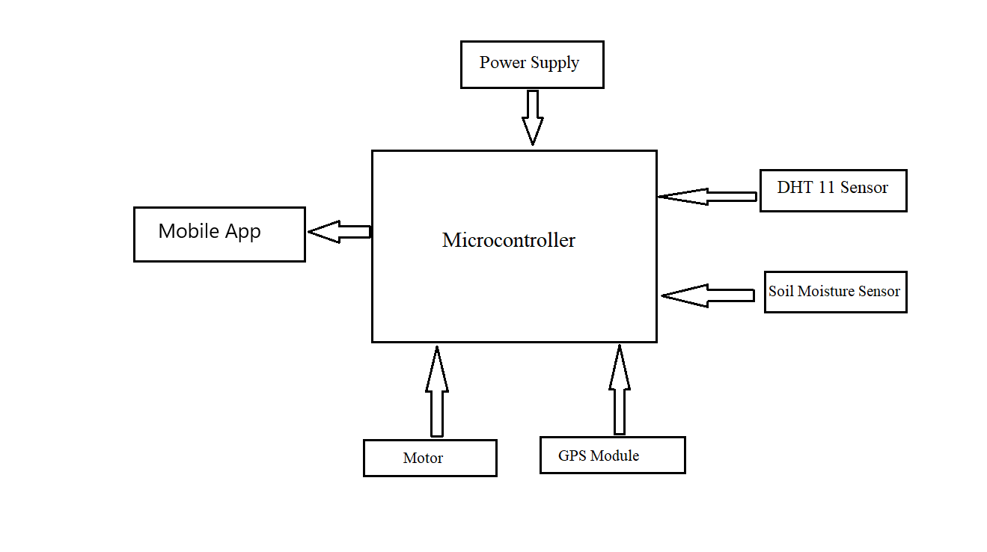
Prototype Model
Hard Design of our visionary project

Slide 17

Solutions for the problem
By ensuring the moisture level of the soil
Having precise water level
Keeping sure of the temperature
Preventing unexpected entrance
Monitor the farm with proper care

Slide 18
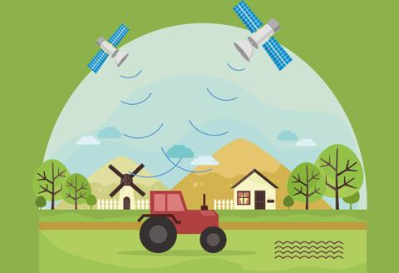
Objectives / Goals
Ensuring the security of an Agro farm
Ensuring the quality of an Agro farm
Checking the temperature, humidity, soil moisture etc.
Controlling service according to weather demand
Human presence detection at certain times

Slide 19
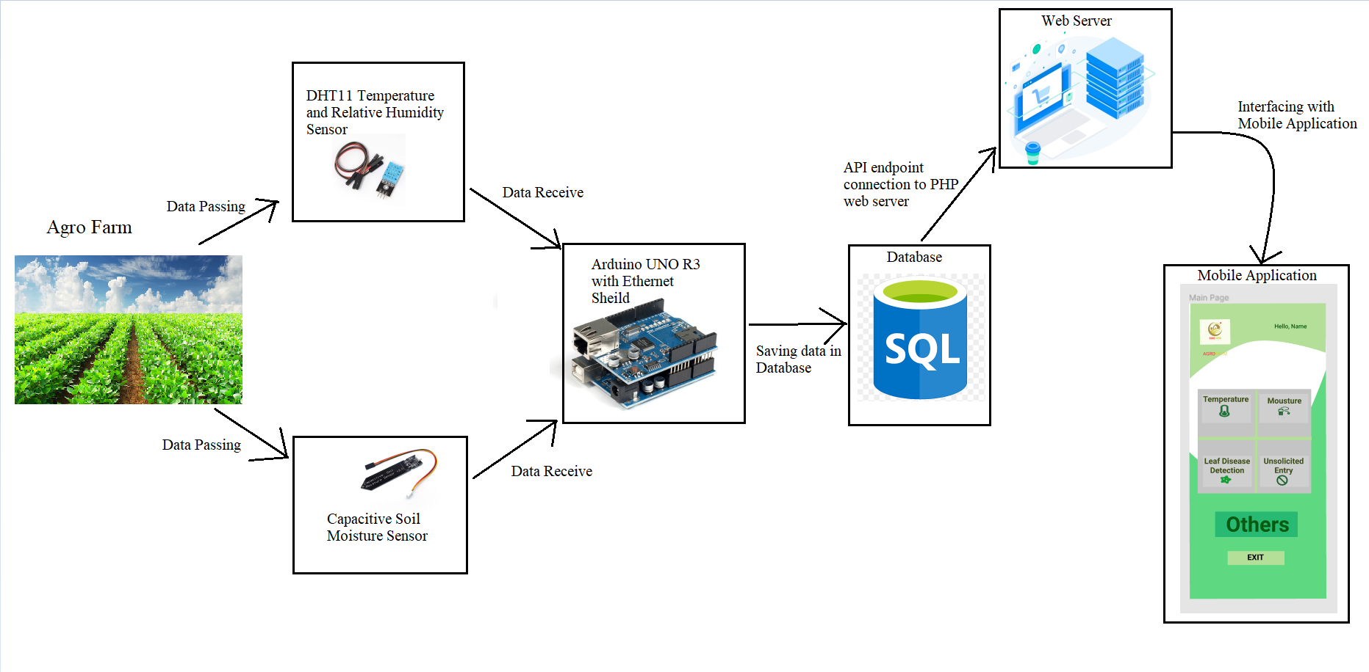
Methodology
Agro Farm Full System Visualization

Slide 20
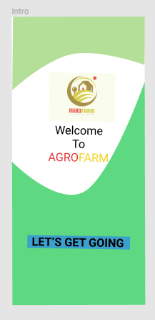
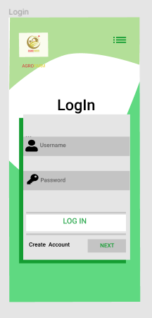
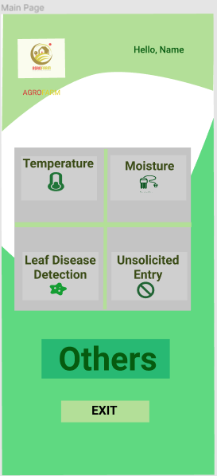
UI Design For Application

Slide 21

Features & Scope
Adopting new technologies in Agro farms
Will always be assured of the safety of the farm
Be able to keep track of the progress
Ensure the quality through the monitoring system
Balanced maintenance
Environmental safety
Digitalize Agro industry

Slide 22

Design Thinking:
There are 4 stages of managing a project based on design thinking principles:
Discover
Define
Develop
Deliver

Slide 23
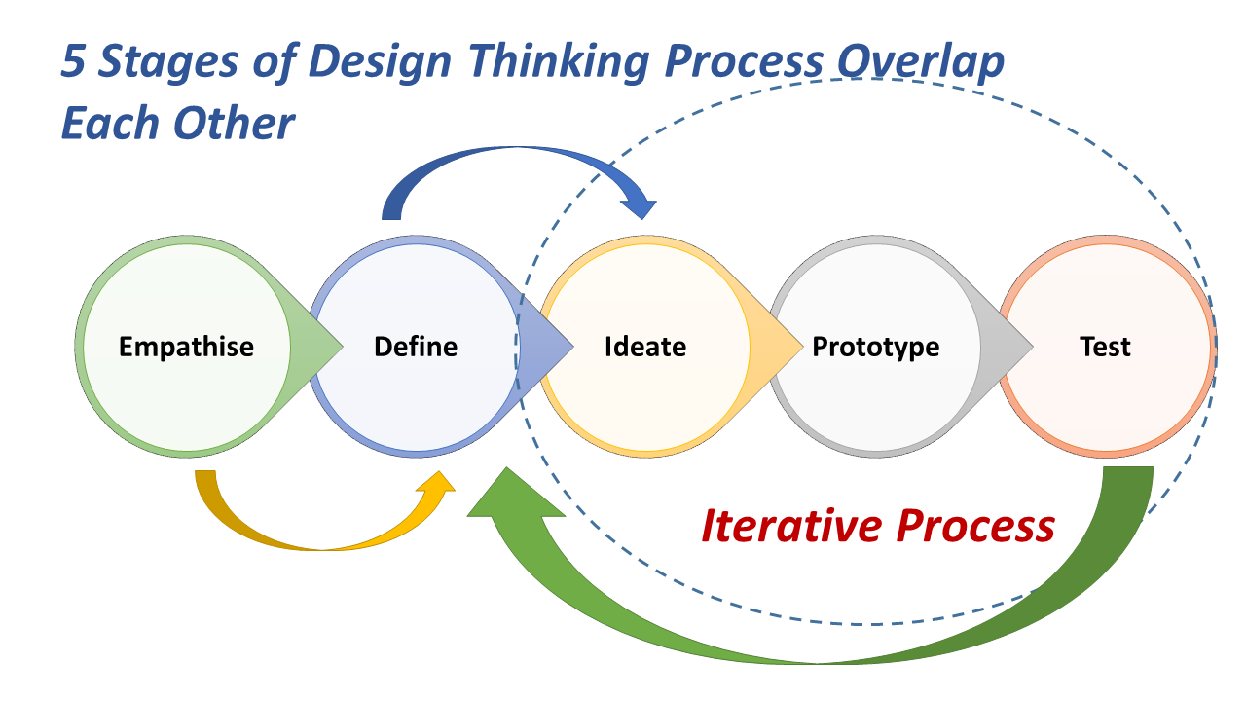

Slide 24

1. Discover
Rapid shrinkage of agricultural land
Inadequate supply of agricultural inputs like fertilizers
Lagging technology in agriculture

Slide 25
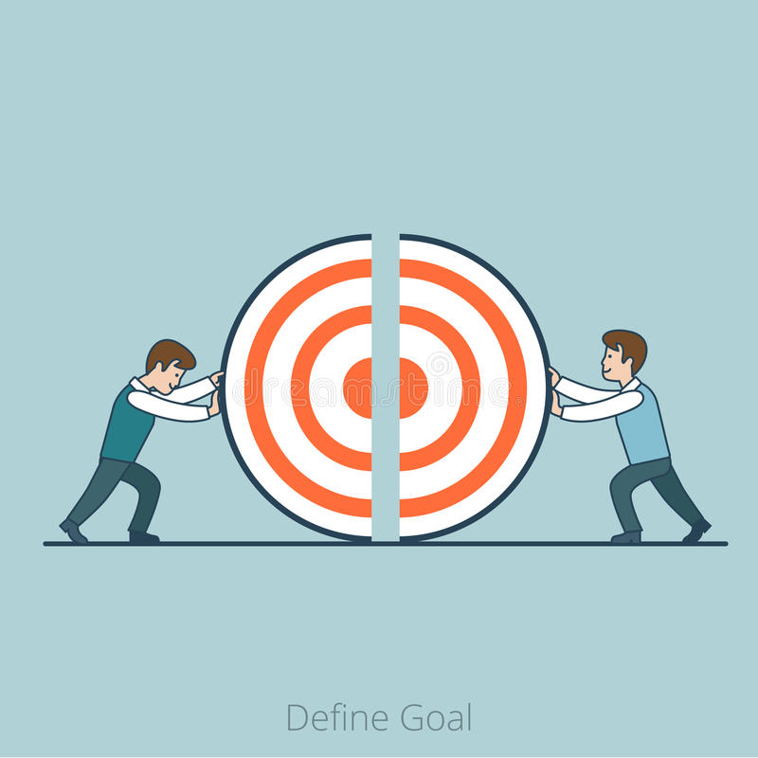
2. Define
Agriculture needs certain attention
Use of modern technologies in this state
Enhancing possibilities
Quality over quantity
Making smart monitoring system an important phase in any agro farm

Slide 26
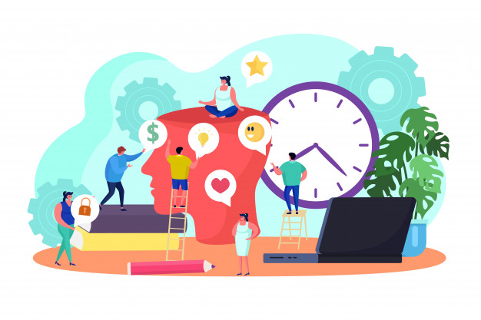
3. Develop
By ensuring the moisture level of the soil
Having precise water level
Keeping sure of the temperature
Preventing unexpected entrance
Monitor the farm with proper care

Slide 27
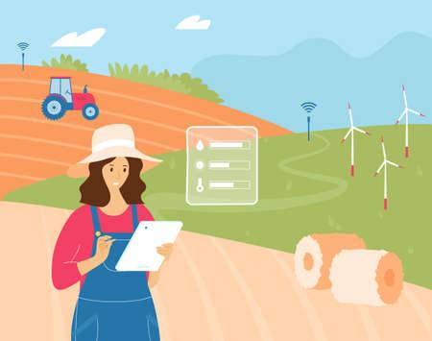
4. Deliver
Good User experience
Easily accessible
Maintenance in proper way
Simply understandable

Slide 28
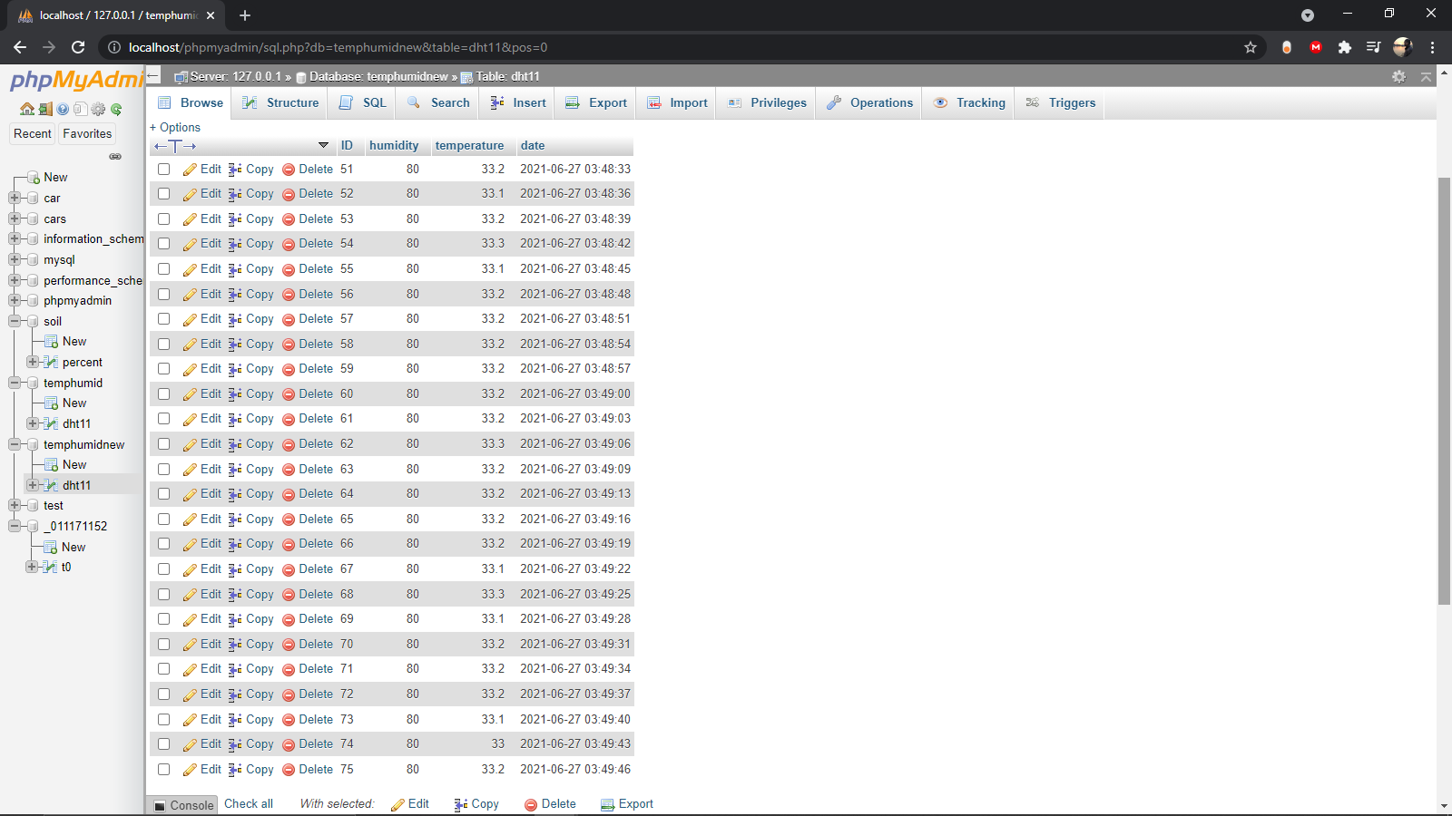
Results
Temperature and Humidity readings

Slide 29
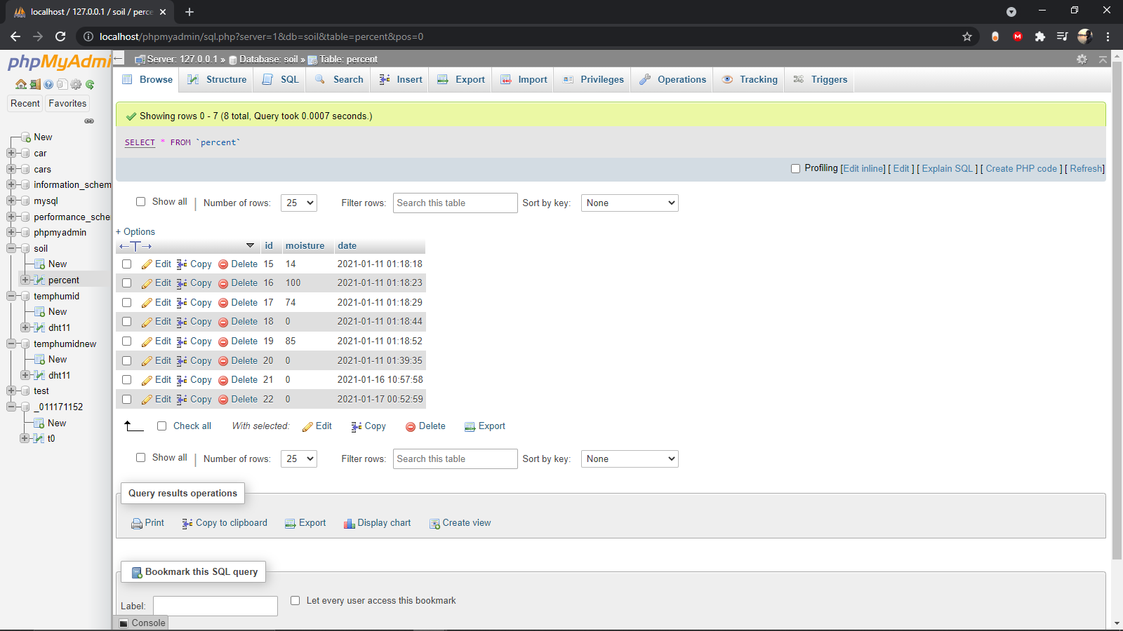
Results
Soil Moisture Readings

Slide 30
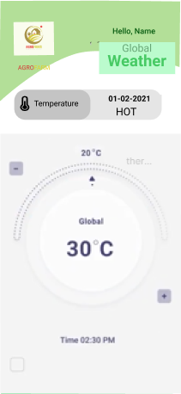
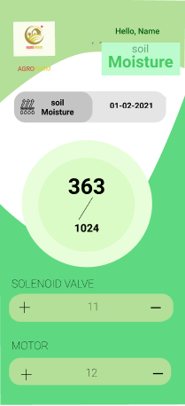
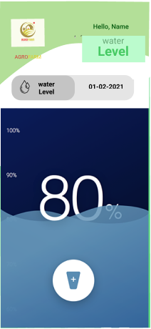
Results

Slide 31










Standards
Standards

Slide 32
Arduino = Used for operating Arduino works
Lucidchart = Used for making diagrams
MySQL = Used for handling Database
Figma = Used for UI design
PHP = Used for backend
Android Studio = Used for making mobile application
VScode= Used for managing PHP
Java = The language of Android Studio
Latex = Used for research paper documentation

Slide 33
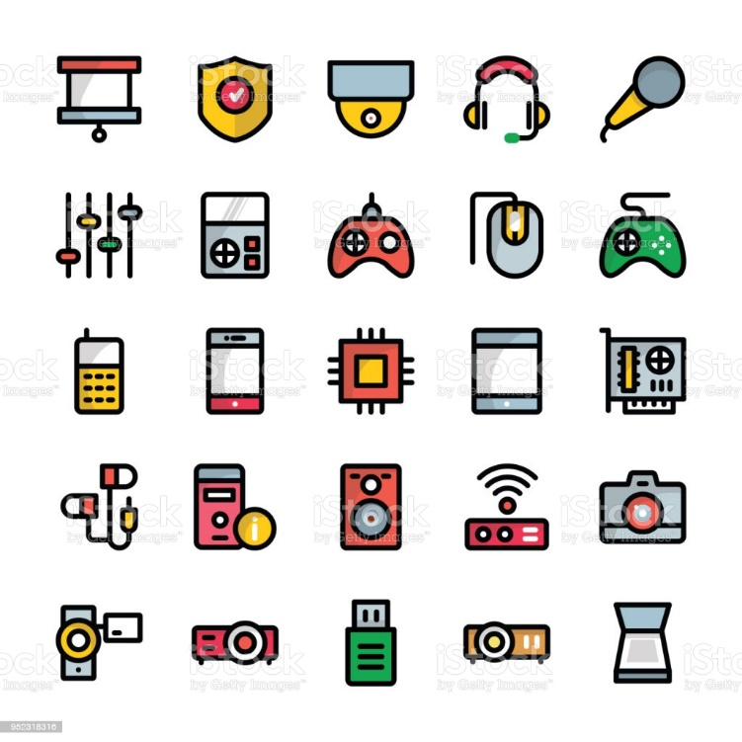
Standard(Hardware Selection)
Capacitive Soil Moisture Sensor
DHT11 Temperature and Relative Humidity Sensor Module for Arduino
Arduino Uno R3
Breadboard
Battery 9V
LCD Display (16X2)
Automatic Infrared PIR Motion Sensor Switch 12V

Slide 34
Constraints
1. Design Constraints
Hardware Limitation on the basis of workload
2. Economic Constraints
Establishing full process is costly
3. Environmental Constraints
Electricity outage is one big concern
4. Ethical Constraints
Help Agricultural aspect of any country
5. Health and Safety Constraints
Main branch of a food chain
6. Social Constraints
Fills occupational need of any agricultural farm
7. Political Constraints
Concerning agricultural side it is a
Naïve approach for any political issue

Slide 35
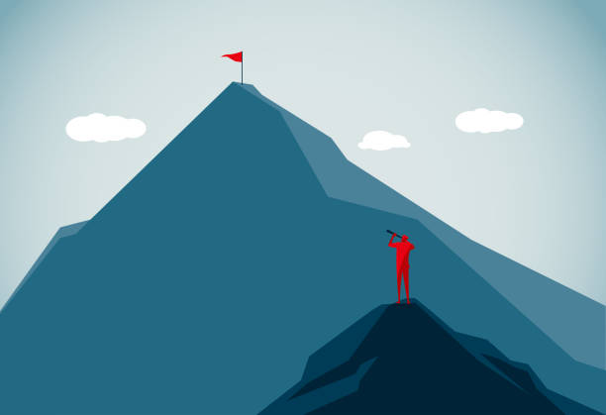
Major Challenges
Connection between Hardware and Database
Connection between Database and Mobile Apps
Finding suitable hardware for the process
Covid Pandemic being a major barrier
in our work progress

Slide 36
Complete Work Schedule
Two Trimester (8 Months):
Milestone for Fall 203:
Scope and feature update
Database and UI design
Component selection
Prototype checking
Milestone for Spring 211:
Research Paper Completion
App Design
App Development
Real World Deployment(Hardware)

Slide 37
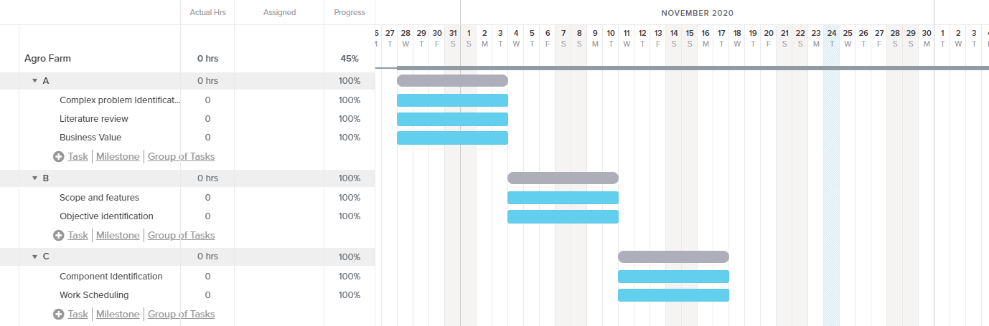
Planning(Fall-203)

Slide 38
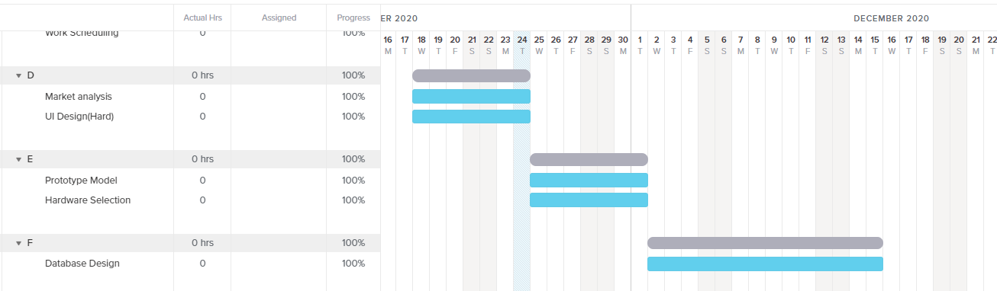
Planning(Fall-203)

Slide 39
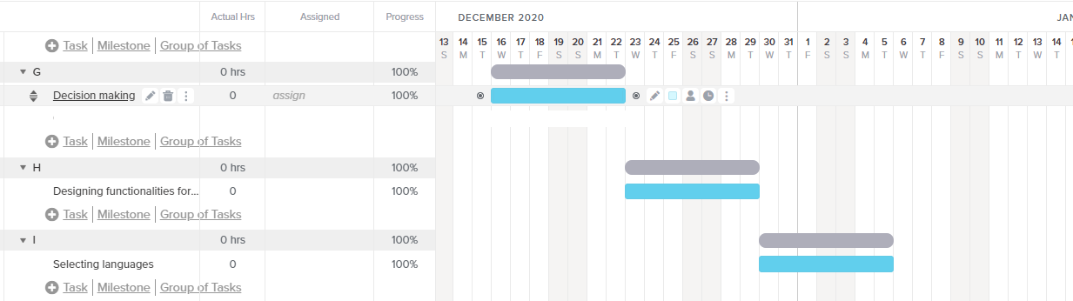
Planning(Fall-203)

Slide 40
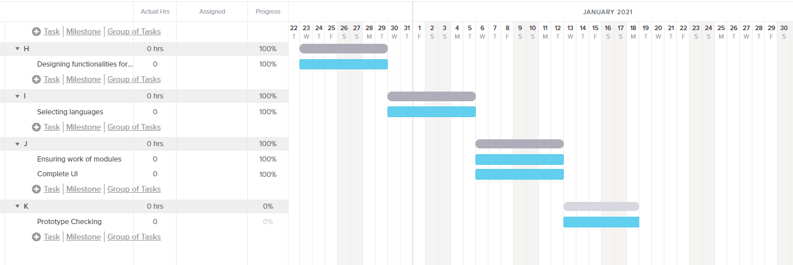
Planning(Fall-203)

Slide 41
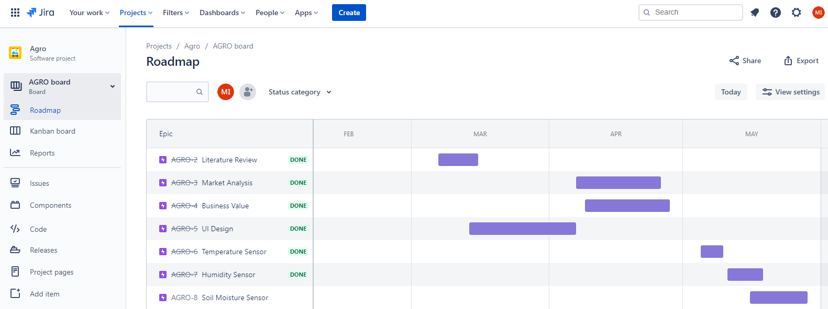
Work Scheduling(Fall-211)

Slide 42
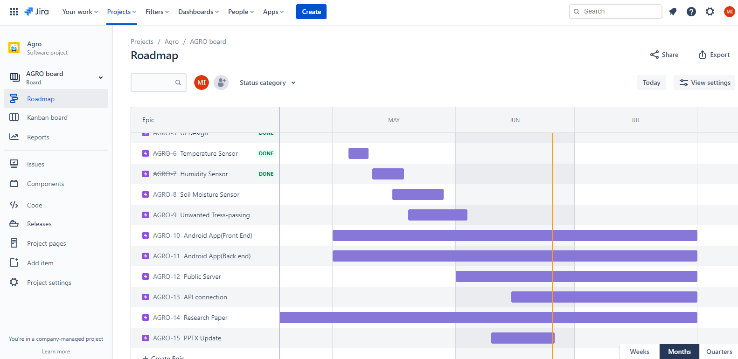
Work Scheduling(Fall-211)

Slide 43
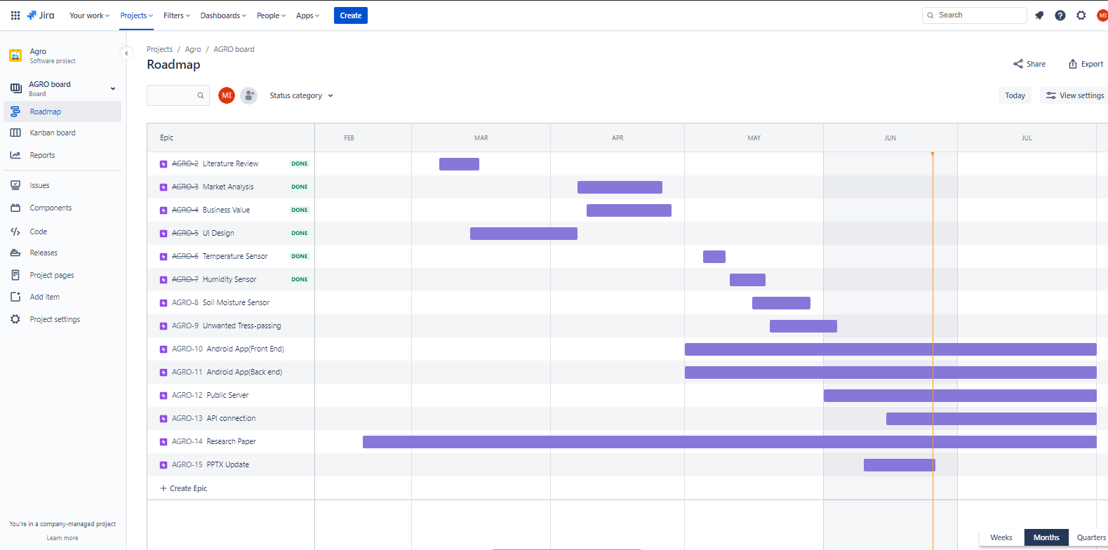
Work Scheduling(Fall-211)

Slide 44
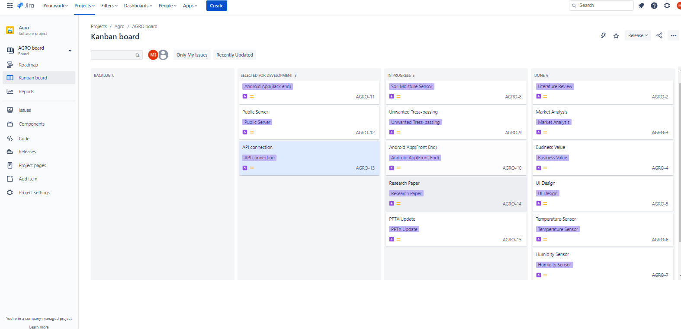
Work Scheduling(Kanban)

Slide 45
Future Work
For tress passing automatically call nearby police station for safety
Automatically increase water flow if moisture is low
Automatically decrease water flow if moisture is high
If temperature is not suited for the crops then take effected measures
Have leaf-disease tracker in Mobile application

Slide 46
Conclusion
This is a system for any Agricultural Farm where quality maintenance is a must.
And the system makes sure every information for the security is always intact.
Very user friendly as every information can be viewed by the Mobile Application.

